Slide 1




Orchestrate your business with Temporal.io workflows
Gwendal Leclerc

Slide 2
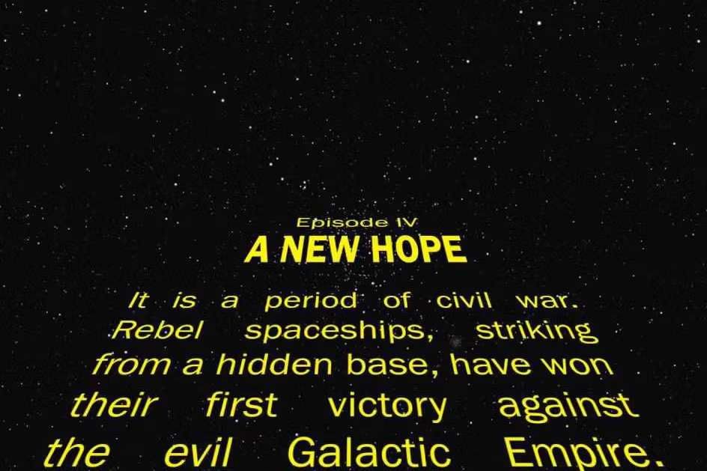
Description

Slide 3
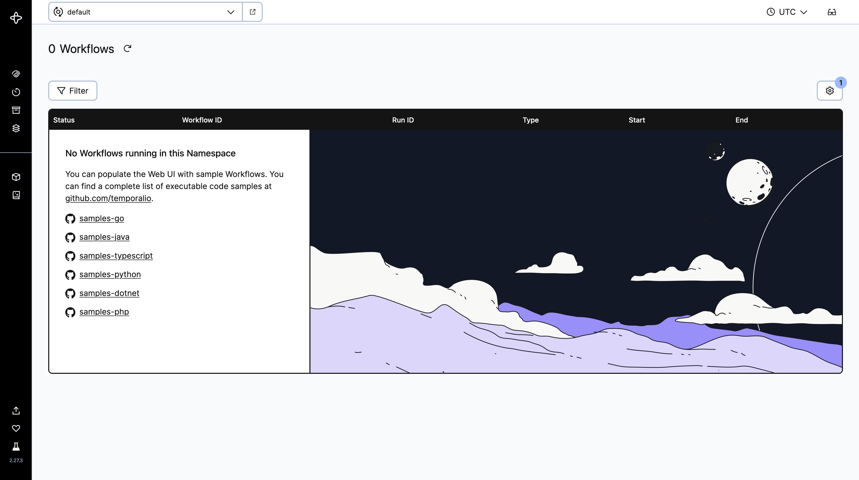
What is it?
Asynchronous task execution platform
Resilient
Open source
Available as SaaS or self-hosted
Based on event sourcing
SDK
Rust, Go, Java, PHP, Python, Typescript, .NET
CLI
Client
Dev Server
UI

Slide 4
Where does it come from?
Created by Maxim Fateev and Samar Abbas in 2019
2004
Maxim is Tech Lead on Amazon Simple Queue Service
2009
Maxim and Samar create Amazon Simple Workflow service
2014
Samar joins Microsoft and create Azure Durable Task Framework
2015
Maxim and Samar join Uber together and create Cadence
2019
Creation of Temporal.io and open sourcing

Slide 5

Overview

Slide 6
Concepts
Workflow
Specifies a sequence of steps and orchestrates the execution of activities
Must be deterministic
Activity
Encapsulates business logic that may fail
Can be automatically replayed in case of error
Can be indeterministic
Worker
Listen on one queue
Execute the code of workflows and activities

Slide 7
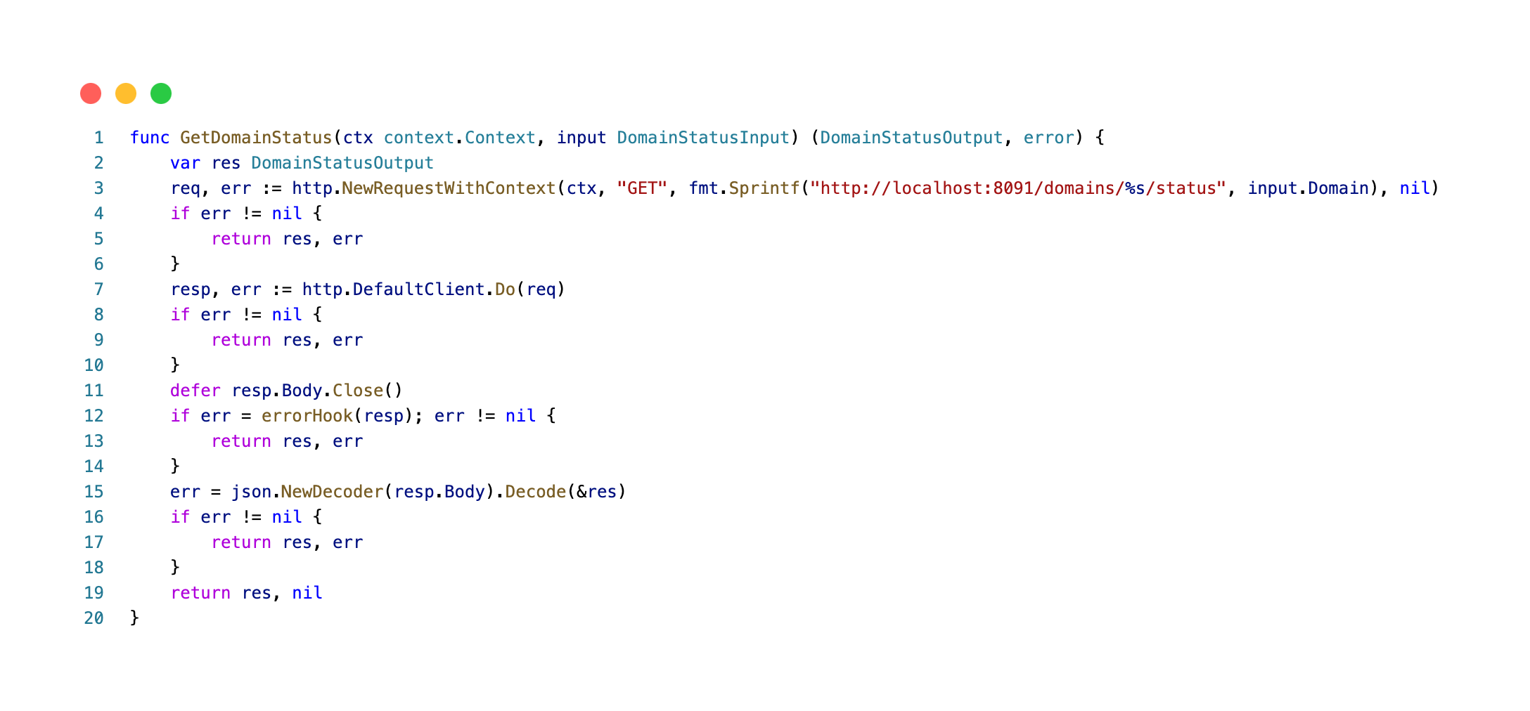
Example: Activity

Slide 8
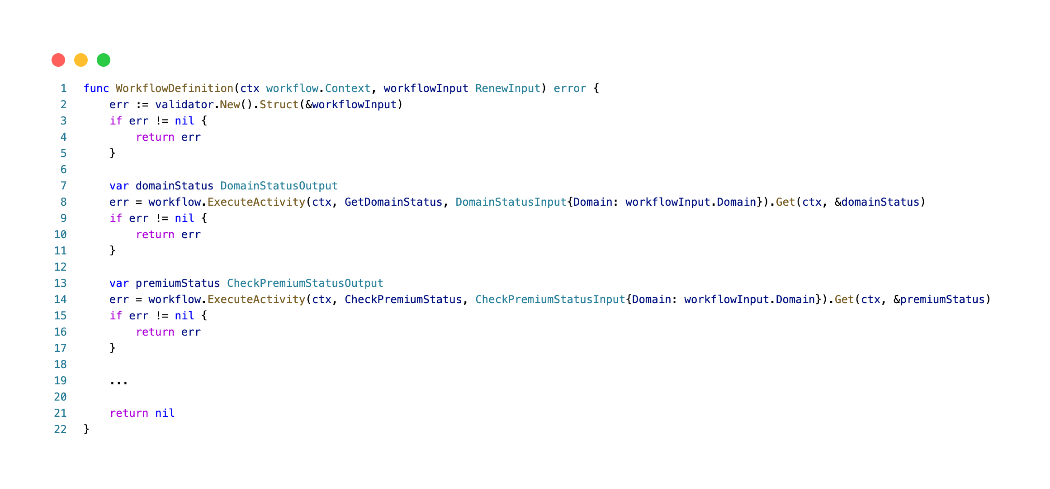
Example: Workflow

Slide 9
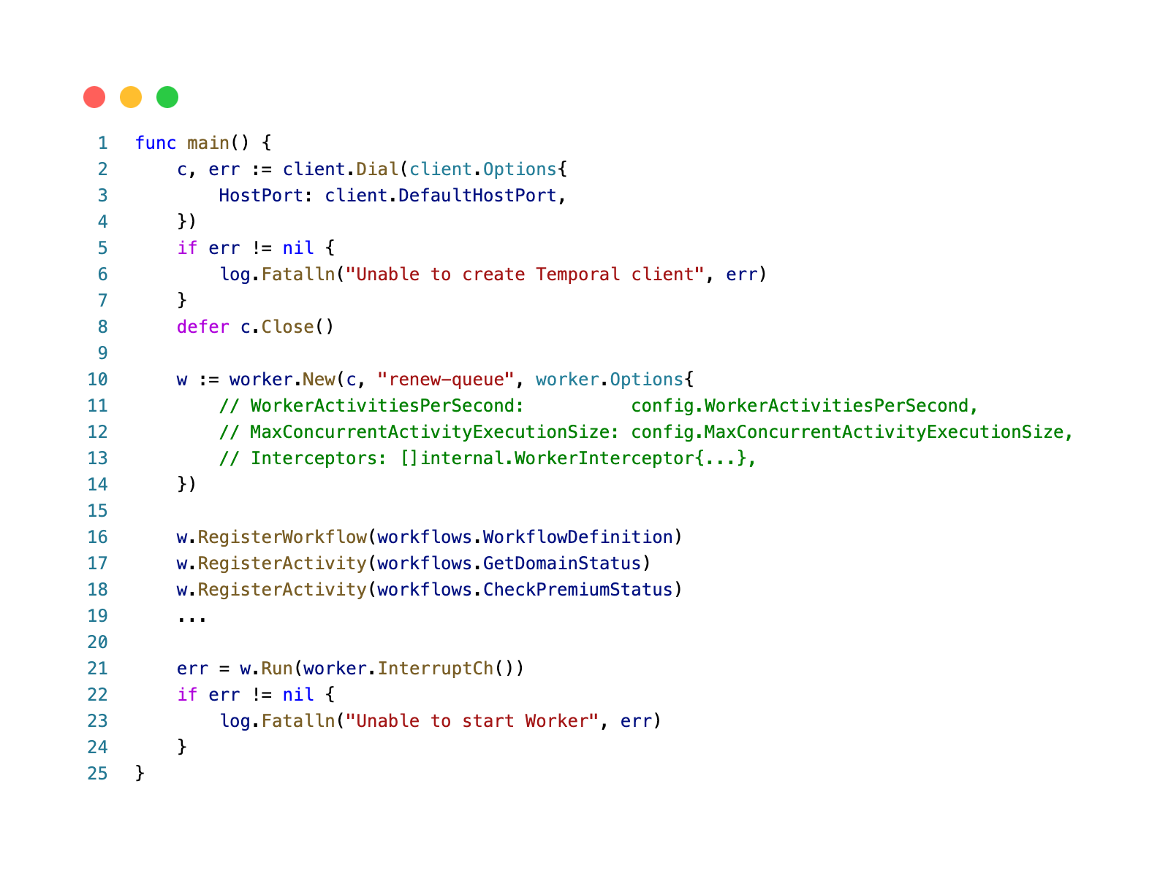
Example: Worker

Slide 10
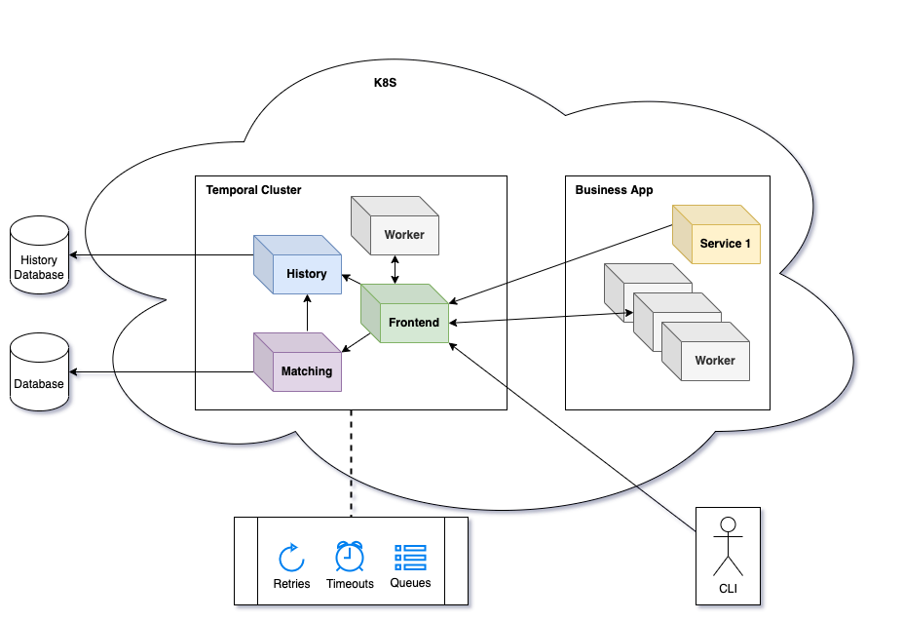
Architecture

Slide 11
Deterministic workflows?
Workflows are "as Code" => they are functions then
How a function/workflow fall asleep without taking resources ?
How to resume the Xth activity in a workflow?
How can another worker take over a workflow that has already started ?
…
Workflows in progress are replayed by workers

Slide 12
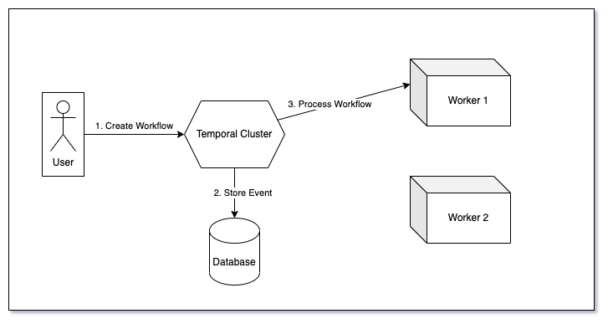
How does it work?

Slide 13
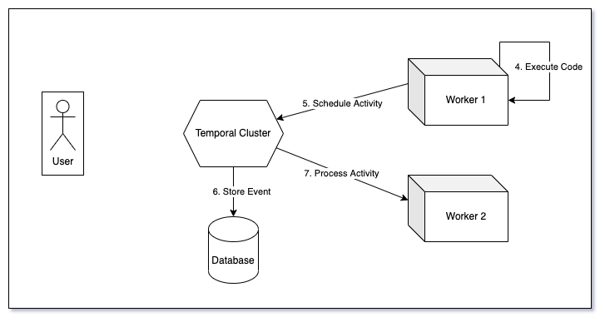
How does it work?

Slide 14
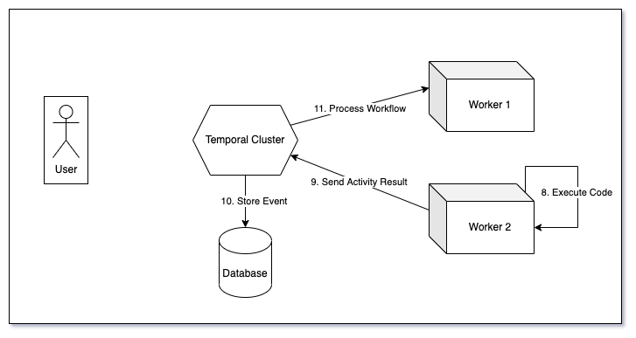
How does it work?

Slide 15
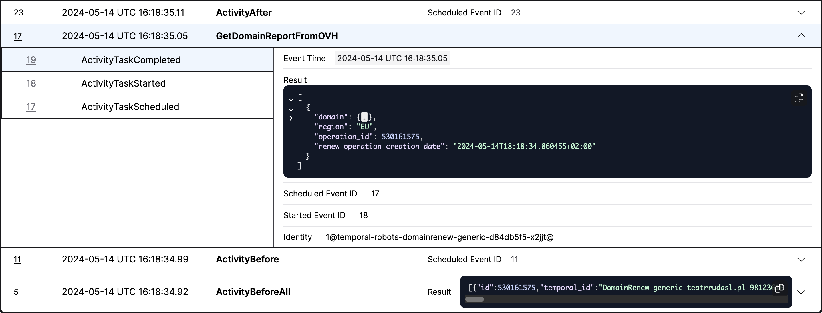
How does it work?

Slide 16

Concrete Case

Slide 17
Domain Team @ OVHcloud
> 5M domain names
37 different business workflows
2.8M workflow executions per month
Including at least 640K on the 1st of the month
External providers with rate limits
API exposed to customers so they can track their operations
Customer interaction on domain operations (re-launch, data correction, etc.)
Potential automatic cancellations with refund

Slide 18
Constraints
Keep a consistent SRE experience
Be compatible with the existing tooling for operations
Be transparent from the user's point of view
Limit the number of activities performed at the same time
Handle cancel cases with refund

Slide 19
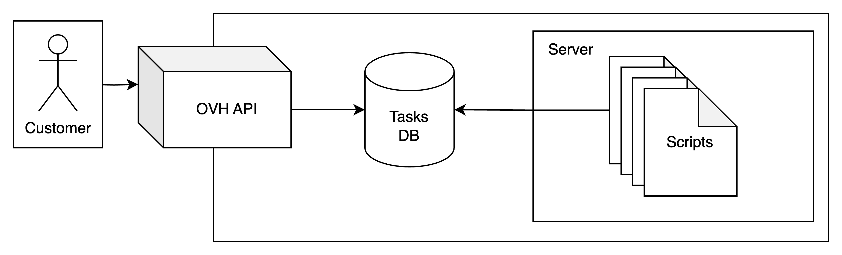
Architecture

Slide 20
Decisions
Migrate renew operations (low complexity + significant added value)
Keep the existing database
Use temporal only as a workflow engine not the source of truth
User actions are handled by the tasks service which will interact with the temporal workflow (reset, signals, …)
Workers synchronize workflow execution with database using interceptors
Cancelation is handled using interceptors
Using activity queues to restrict activity concurrency using interceptors

Slide 21
Concepts
Interceptor
Looks like middleware in web frameworks
Not well documented yet
Allows to modify, augment, or even short-circuit inbound and outbound SDK calls of workflows and activities

Slide 22
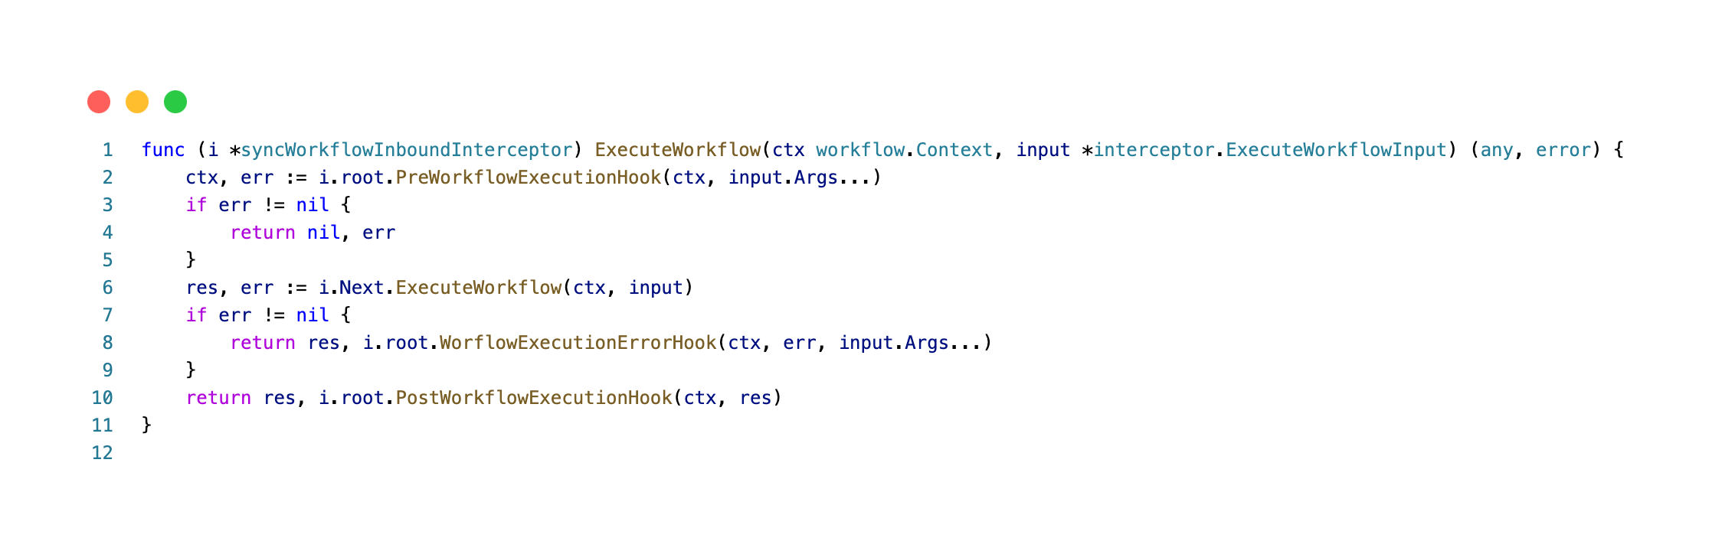
Example: Interceptor

Slide 23
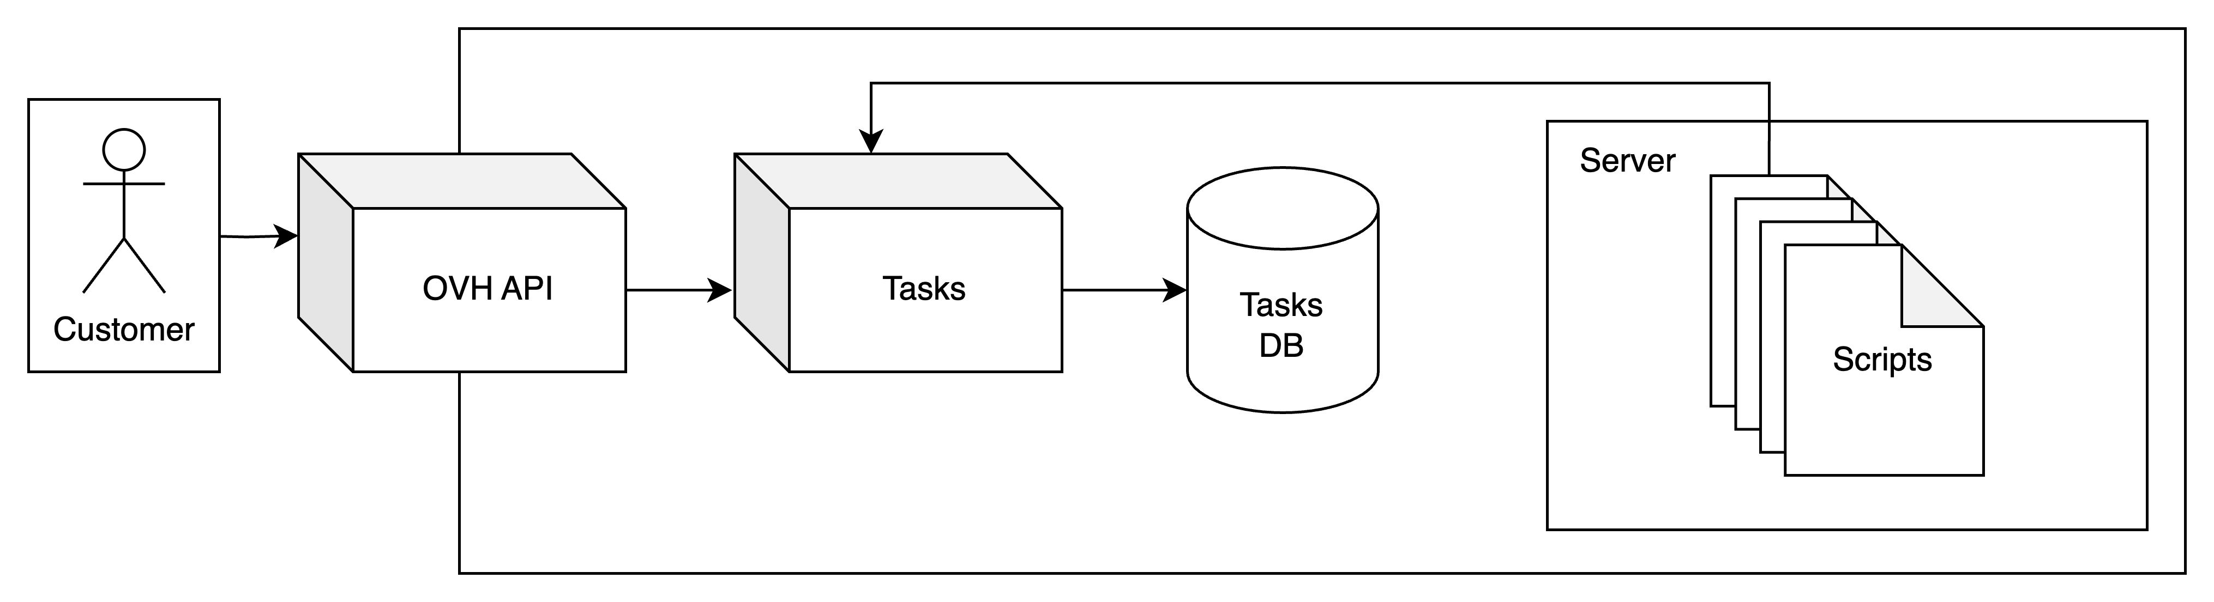
Architecture

Slide 24
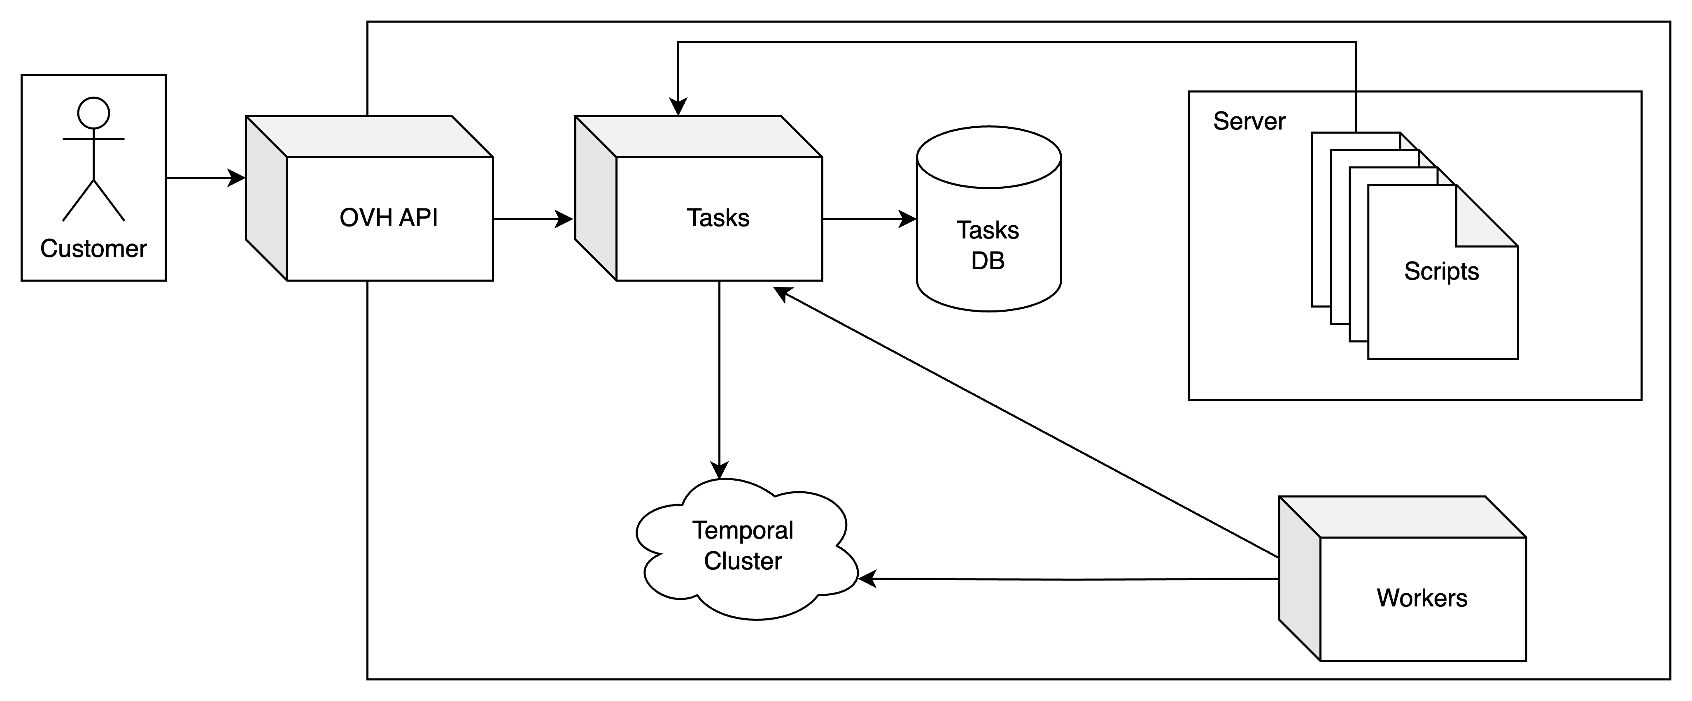
Architecture

Slide 25

Production

Slide 26

Migration of .info
Enabled using feature flipping
Small load (~4 500 op/month)
No major problems 🤗
Until 1st of the month…

Slide 27

Migration of .info
Duplicate operations 🙀
Detected quickly
Not caused by temporal
Rescued by the idempotence of the new workflows 😅

Slide 28

Migration of .fr
Same workflow
Bigger load (~125 000 op/month)
Rate limits on workers
WorkerActivitiesPerSecond
MaxConcurrentWorkflowTaskExecutionSize
No major problems 🤗
Until 1st of the month…

Slide 29

Migration of .fr

Slide 30
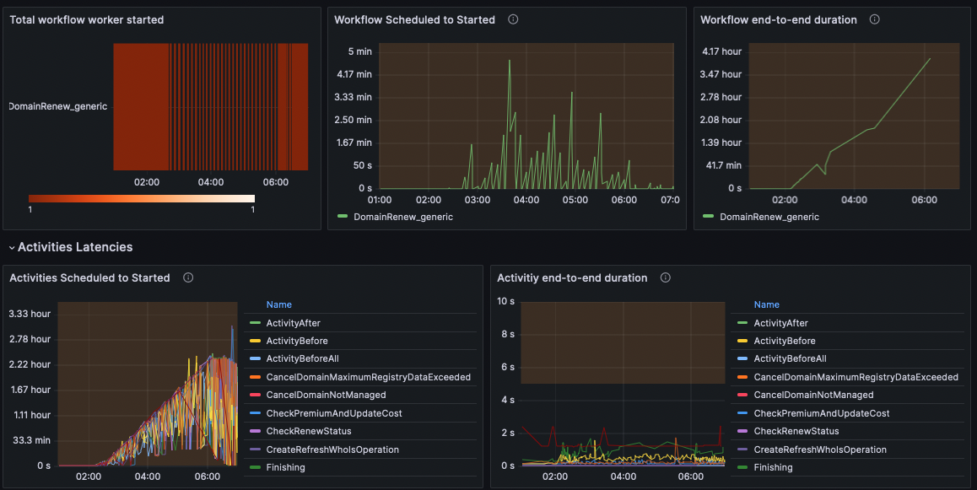
Migration of .fr
Workflows take a long time to be processed
Workers don't seem overloaded
Scaling up workers doesn't fix the problem
Change the rate limits doesn’t fix the problem

Slide 31
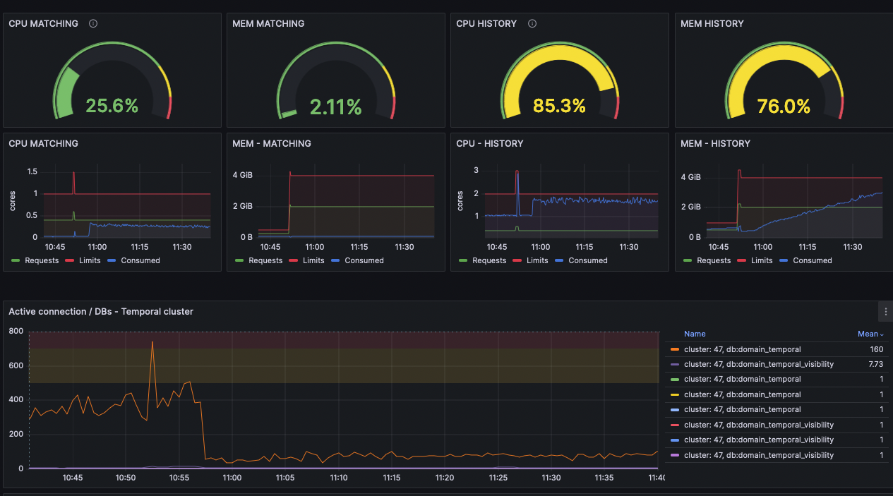
Migration of .fr
Temporal history service overloaded
Too many idle connections on DB
Scaling up the temporal services does fix the problem but…

Slide 32
Migration of .fr

Slide 33
Migration of .fr
1M queued tasks processed in less than 30 min 🚀
Services called by workflows were saturated
As we use a connection pool to manage registry calls, quite a few of calls timed out
Workflows were failing du to that
Reconfiguration of rate limits + bulk relaunch of workflows (reset before the last activity) and everything were good ✅

Slide 34
Results
We configured auto scaling on temporal cluster
Everything is stable since then
We process 600K operations each month
80% of renew operations are migrated
Average renewal time reduced from 5 minutes to 5 seconds
We plan to use temporal for other types of asynchronous workflows

Slide 35
Useful links
Website: https://temporal.io/
Github: https://github.com/temporalio
Courses: https://learn.temporal.io/
Documentation: https://docs.temporal.io/
Blog: https://temporal.io/blog
Slack: https://temporal.io/slack
Examples:
Go: https://github.com/temporalio/samples-go
Java: https://github.com/temporalio/samples-java
Typescript: https://github.com/temporalio/samples-typescript
Python: https://github.com/temporalio/samples-python
PHP: https://github.com/temporalio/samples-php
.Net: https://github.com/temporalio/samples-dotnet

Slide 36

Thank You
If you want to give some feedbacks:

